Slide 1
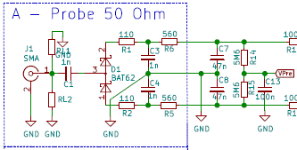

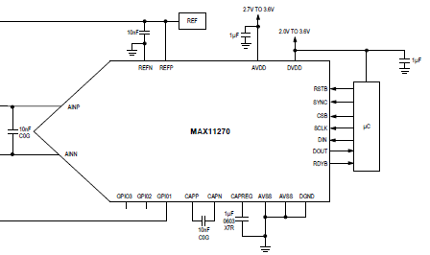
RF Voltmeter Block Diagram
Jacques Audet
Channels: A, B, C, D
Need to read:
9 VDC @ +23 dBm
2 µVDC @ -60dBm
X1 gain
buffers
3.6V LDO
Regulator
3.6V
Attenuator
X1
X0.2
3.3V
3.3V LDO
Regulator
Vpre
+1.3V
From
Control
Board
3.6V
3.6V
MUX
4 to 1
3.3V
Chopper (Zero-Drift) Amplifier
2 Circuit Rail-to-Rail 8-SOIC
AD8639ARZ-REEL7CT-ND
B --- Probe 50 ohms
RC- Filter
24 bit ADC
MAX11270
To identical Attenuator, Buffers, MUX
C --- Boonton Probe
High Impedance
MUX and
Attenuator
Control
ADC Gain/atten used:
Gain Atten Range
1 0.2 x 1
4 1 x 2
128 1 x 3
D --- DC input only
The ADC data is processed to display dBm, dB, mV, mW
The controller does all calculations and displays on a LCD panel.
The RF Voltmeter may be battery powered.

Slide 2
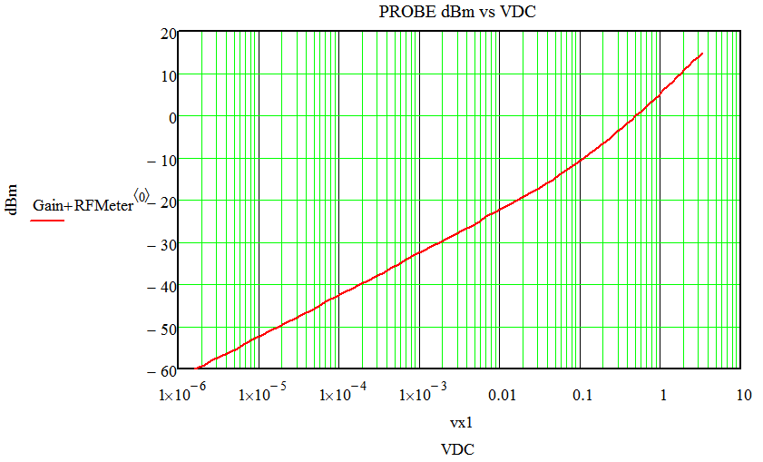

Measured Response with CH A or B using BAT62 diodes
Range 1
-5 dBm
Range 2
dBm
-25 dBm
Range 3
Probe out VDC
Each range has its own compensation curve.
The three curves each use different polynomials to calculate the input Volts and dBm levels based on the code read by the ADC
Calibration process:
For every dBm input level the ADC codes are read and recorded to generate the polynomial that best fits the measured data, for each range.
The controller transmits (continuously or on demand) the ADC decimal value read over USB to the host computer. Labview .vi files available
The measured data is transferred to an Excel file: RF_Probe_Measurements-Calib1.xls which may is used to compute the coefficients of the polynomials.
The calibration coefficients may be loaded into the controller via a JSON file, as well as other data to be stored in non volatile memory.

Slide 3




PCB PILEUP
SW1
J. Audet
Rev. 1
1040
395 mil
Not to scale
425 mil
DISPLAY 3.5 in.
220 mil
socket
Component side
1
J5
12
14 pins
CTRL Board
3.9 x 3.9 in
1931 mil
900 mil
Battery
holder
NOTE 1
200 mil
Batt Board / shield
SMA
Component side
ADC Board
12
1
3.9 in.
NOTE 1
Provision is made to separate
the control board and the ADC
board using a flat cable
J1
CTRL Board
3.9 x 3.9 in
SIDE VIEW
Batt Board / shield
ADC Board
SMA
SMA
2.9 in.

